Slide 1
Universal Screeners for Number Sense
Forefront Education
Information Zoom Presented by
MC² MOST

Slide 2
USNS General Information
Developed as a “quick check” for number sense
Aligned to AVMR concepts of number
Aligned to CCSS-M grade level standards
A set of screeners for each grade, K - 5
3 screeners for each grade (fall, mid-year, spring)
Scored using a 3-point system and a scoring guide

Slide 3
USNS - MC² MOST Info
MC²M will use the screener data to generate reports for our grant
All students participating in MC²M tutoring will be screened
All assessment interviews will be videotaped; videos will be uploaded into our USNS database
All 3rd - 5th grade students will be given the 3rd grade Fall Screener and the 2nd grade Fall Screener
1st and 2nd grade students will be given their grade level appropriate Fall Screener
Students must score in the red or low orange range to be eligible for tutoring.

Slide 4
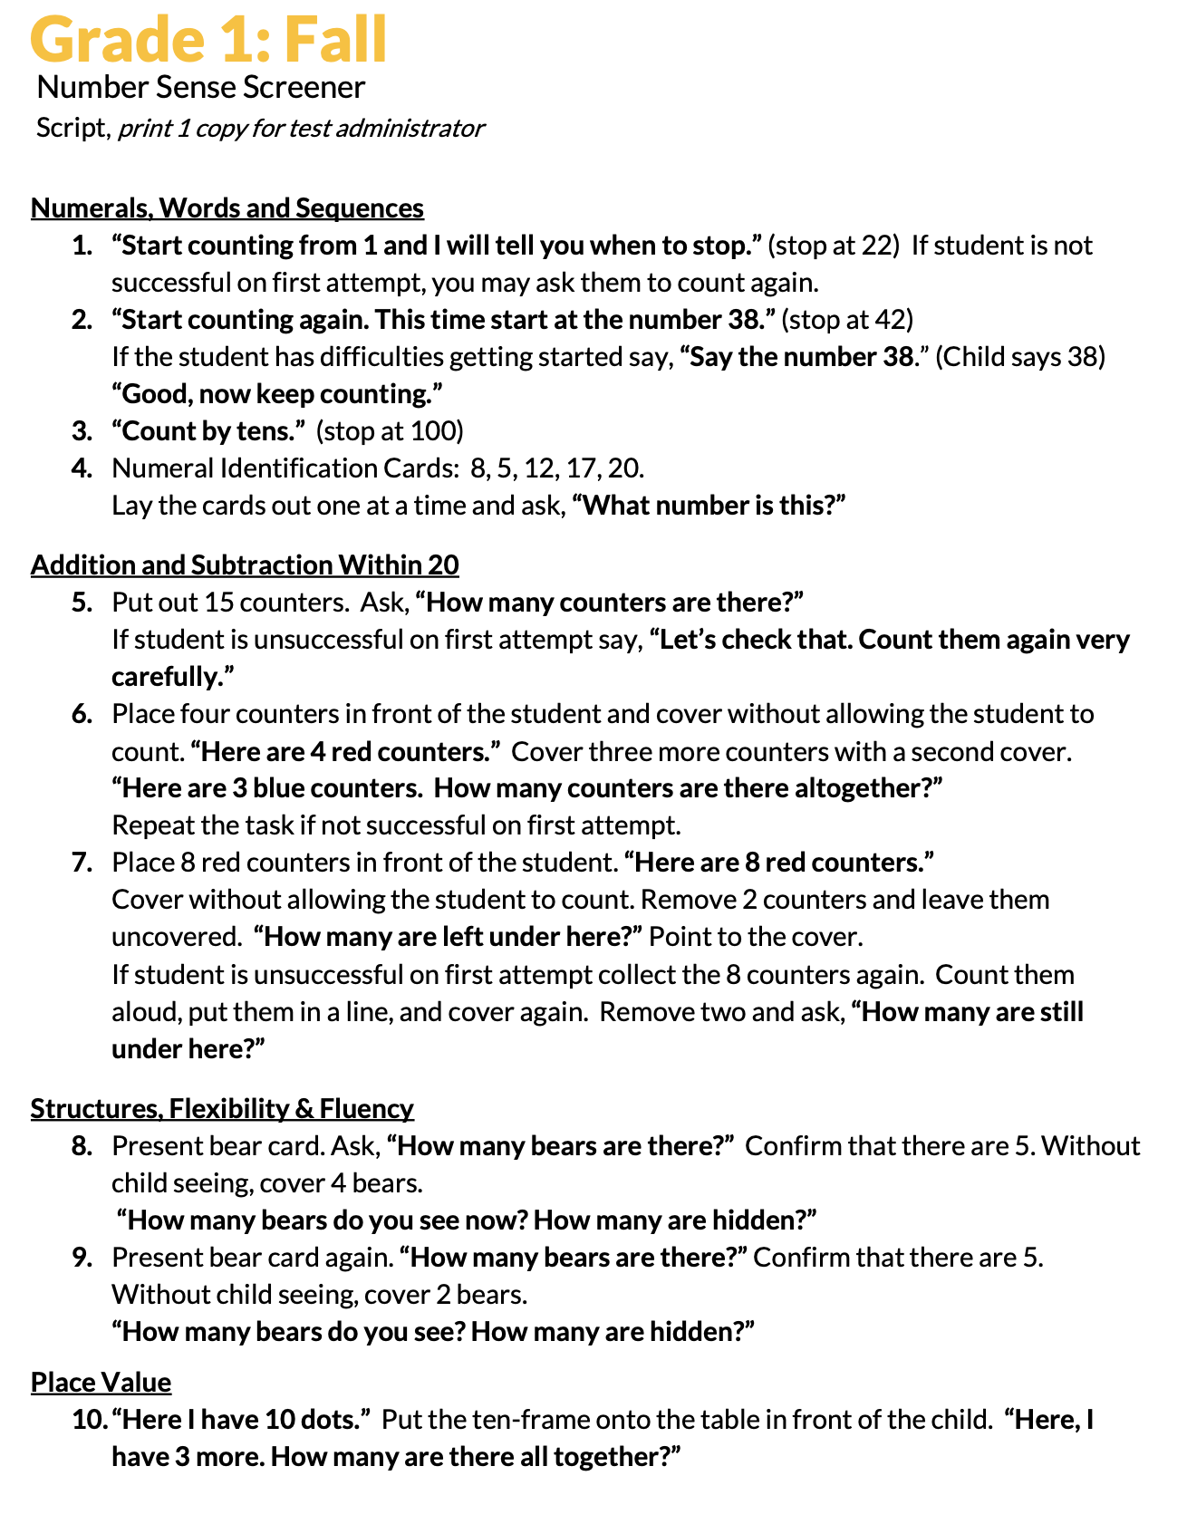
Fall Screeners: Scripts (provided in Spanish & English)

Slide 5
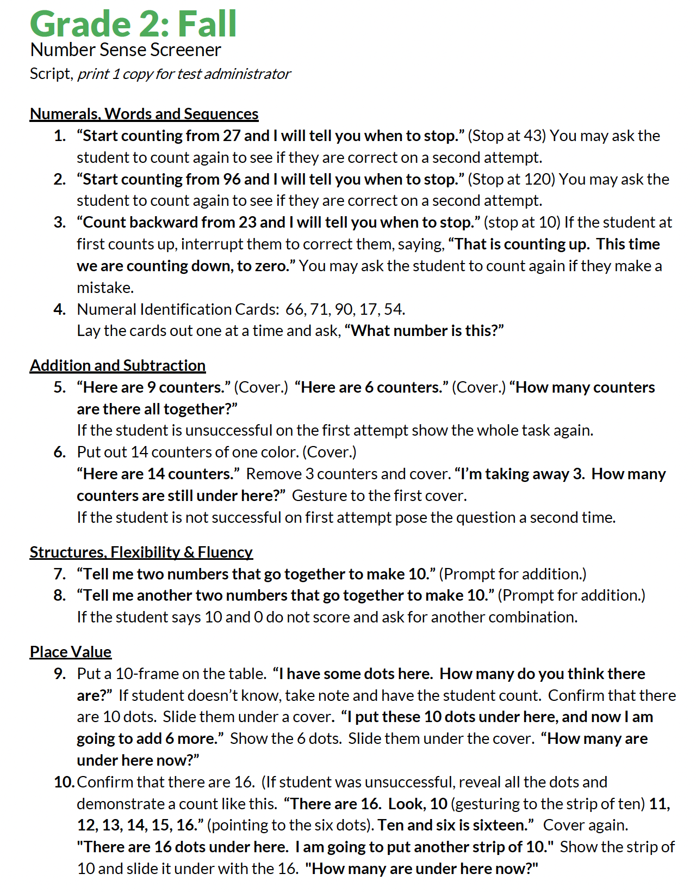
Fall Screeners: Scripts (provided in Spanish & English)

Slide 6
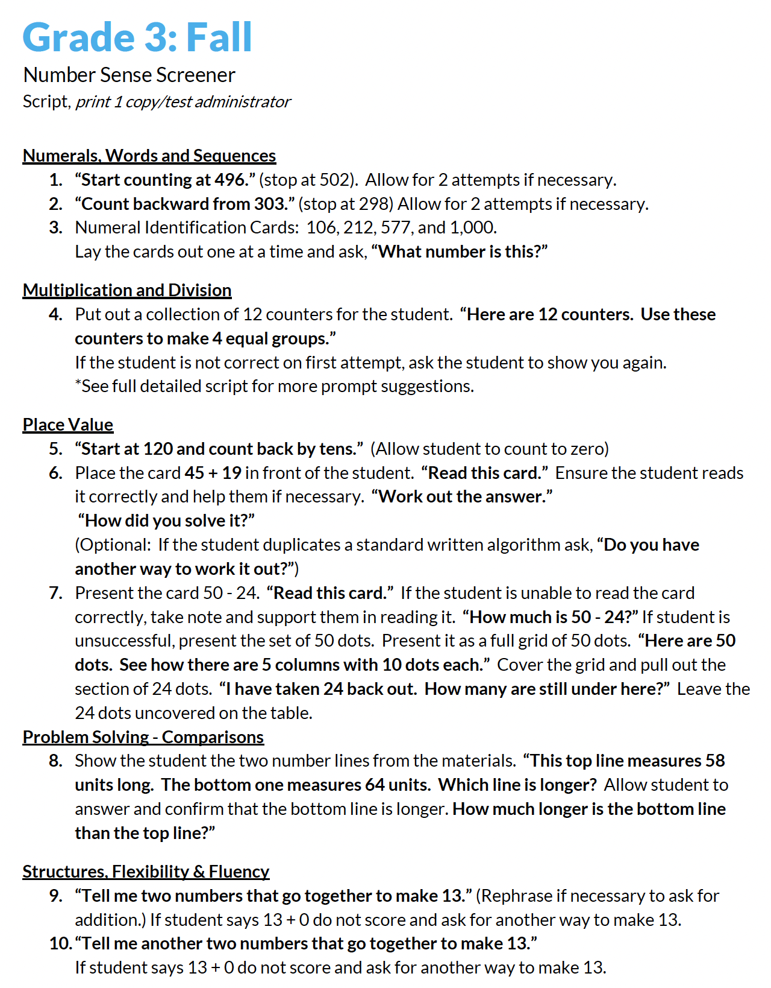
Fall Screeners: Scripts (provided in Spanish & English)

Slide 7
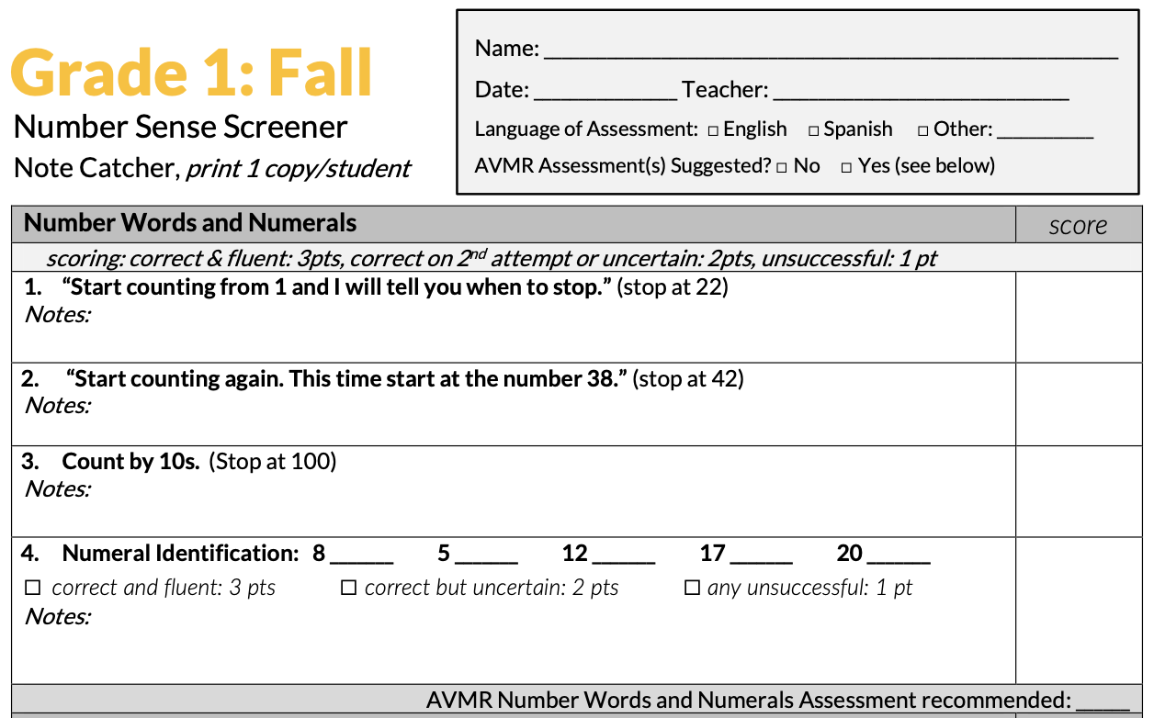
Fall Screeners: Number Words and Numerals

Slide 8
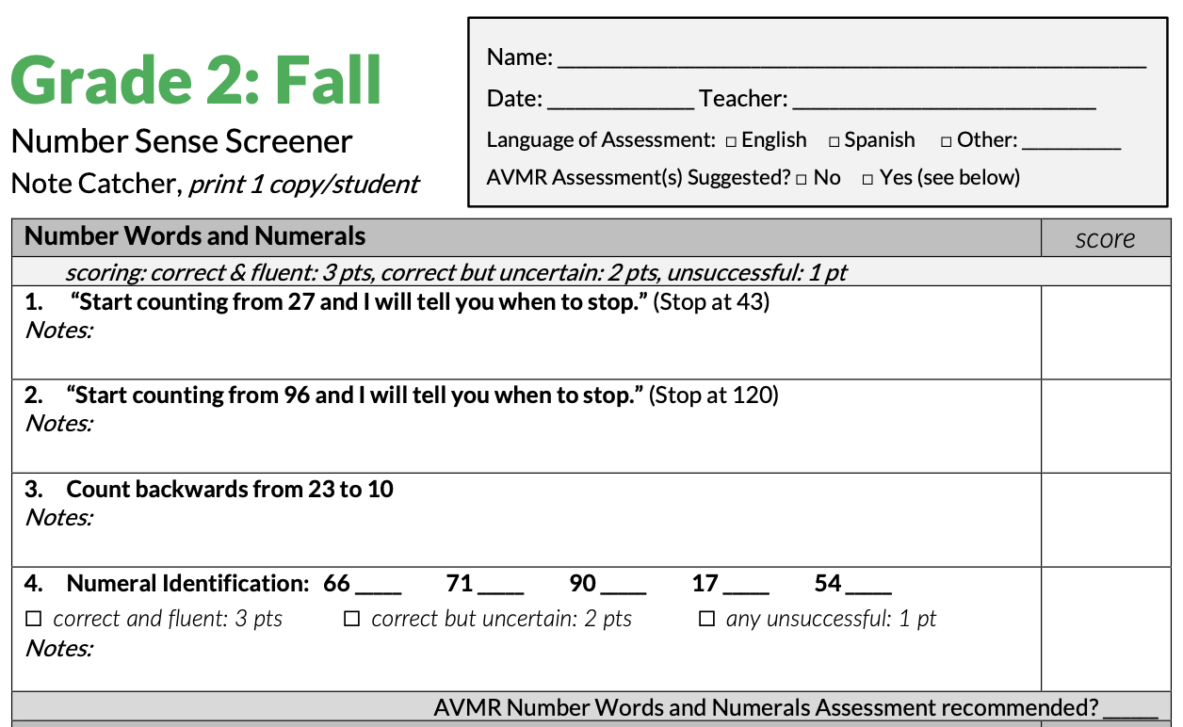
Fall Screeners: Number Words and Numerals

Slide 9
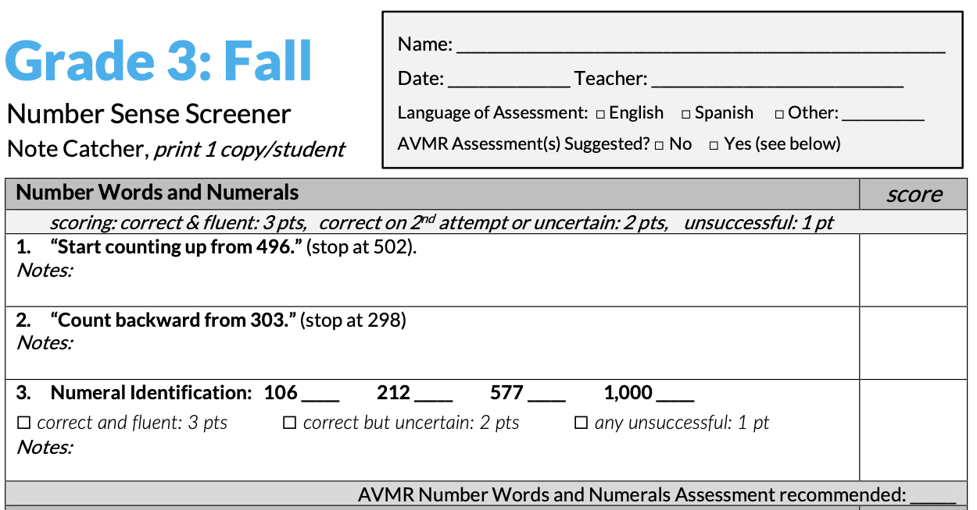
Fall Screeners: Number Words and Numerals

Slide 10
Fall Screeners: Addition and Subtraction

Slide 11
Fall Screeners: Structuring Numbers

Slide 12
Fall Screeners: Structuring Numbers

Slide 13
Fall Screeners: Structuring Numbers

Slide 14
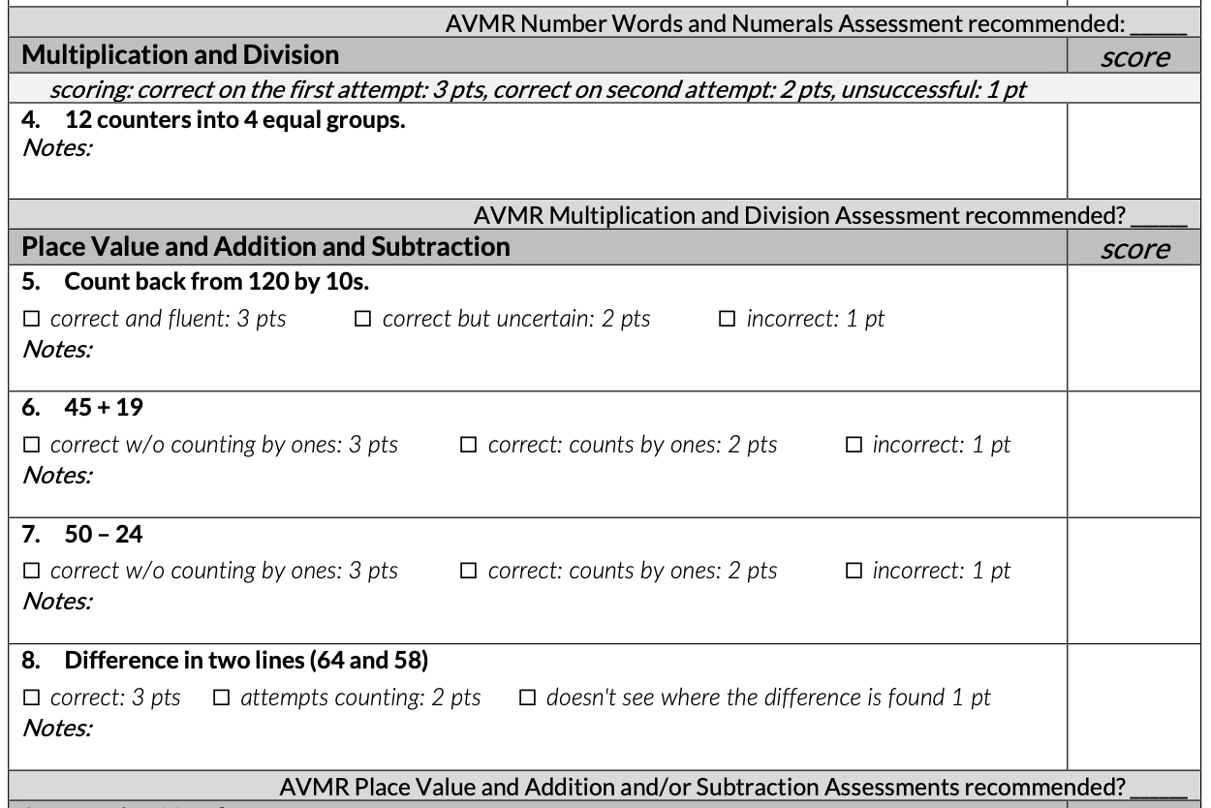
Fall Screeners: (Place Value and Multiplication)

Slide 15
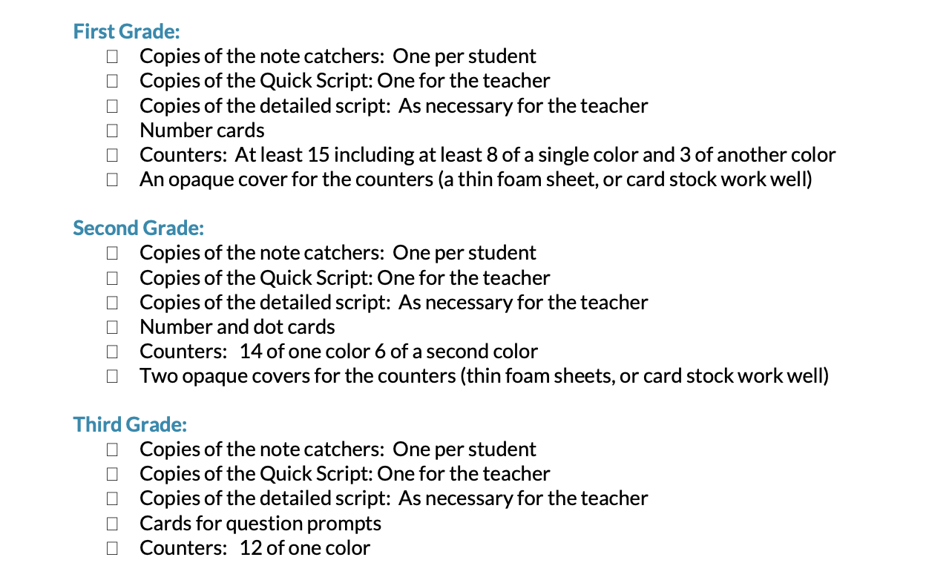

Slide 16
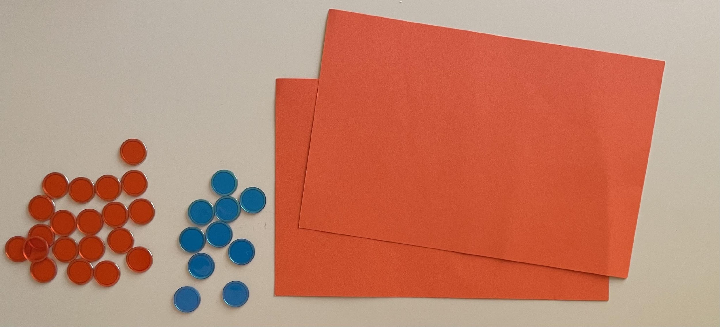
Fall Screeners: Materials
30 counters ( 20 / 10 ) and 2 screens
one set of counters & screens can be used to administer 1st, 2nd & 3rd grade interviews

Slide 17
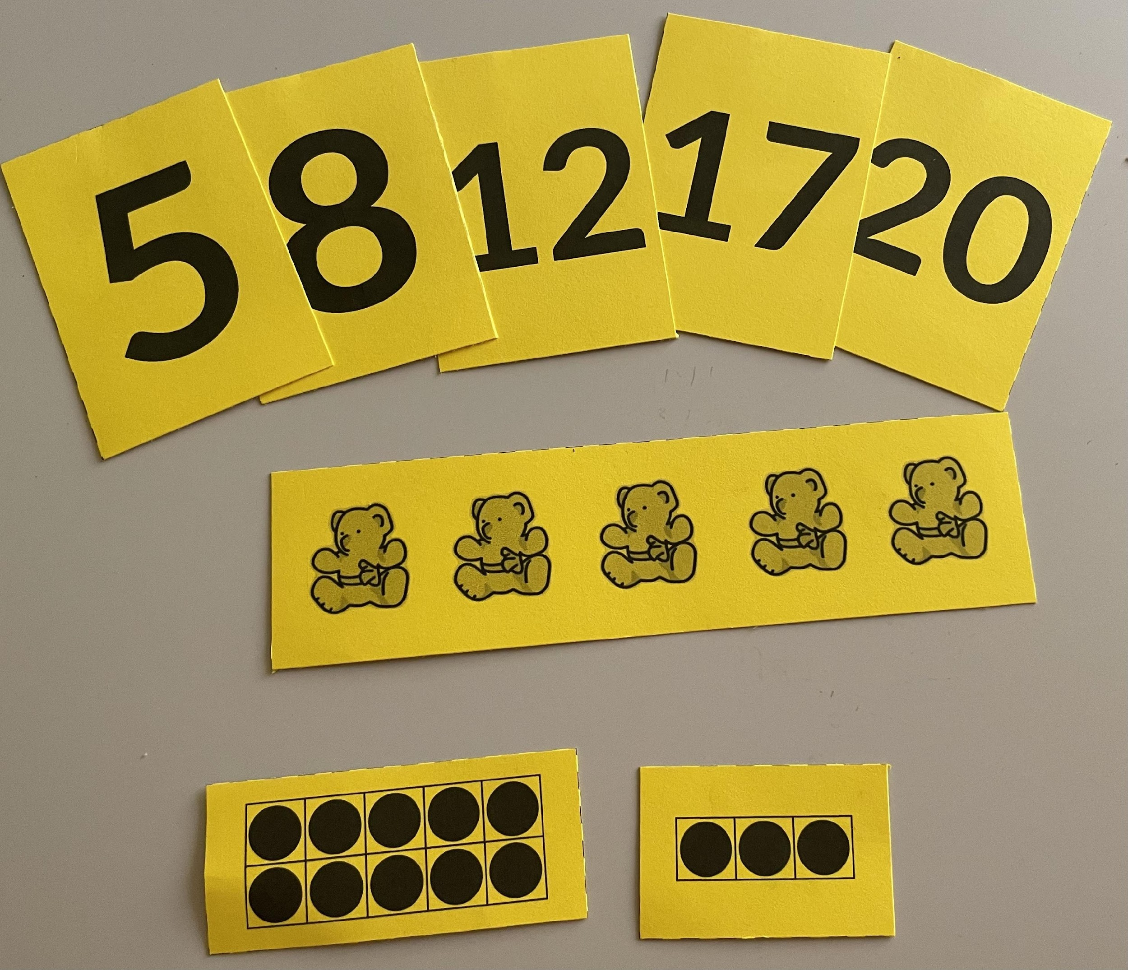
Fall Screeners: Materials (printable)

Slide 18
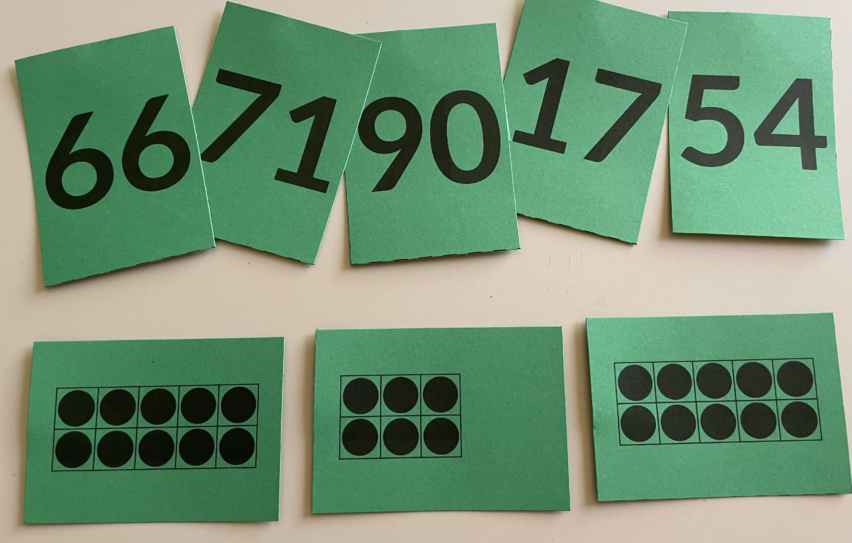
Fall Screeners: Materials (printable)

Slide 19
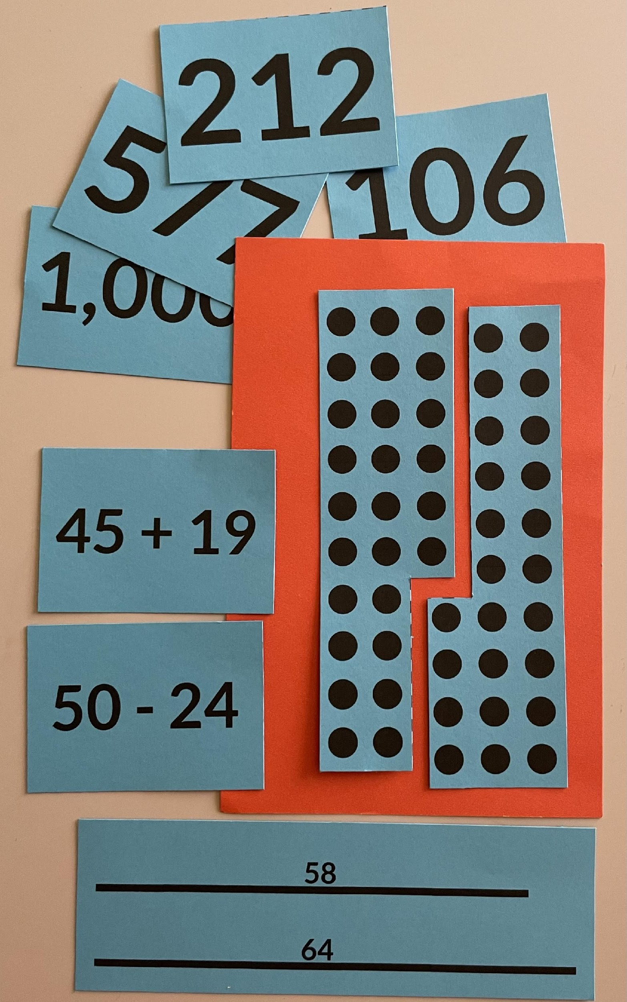
Fall Screeners: Materials

Slide 20
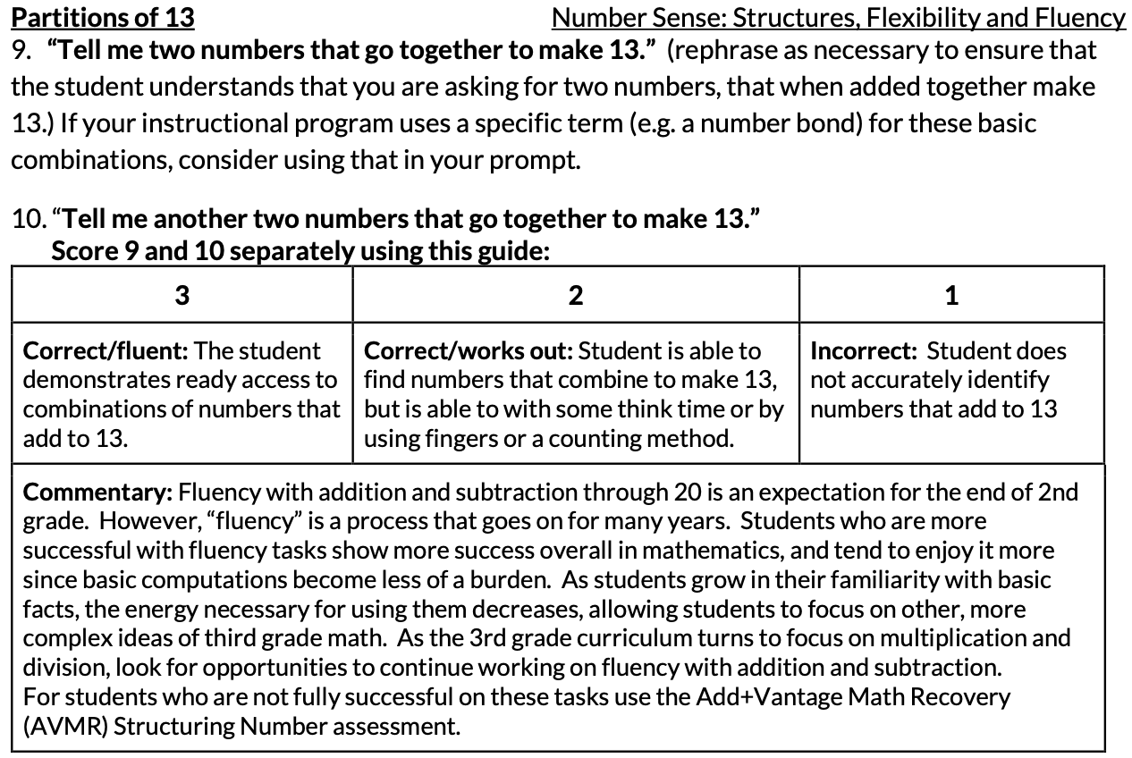
Fall Screeners: Detailed Script and Scoring Guide

Slide 21
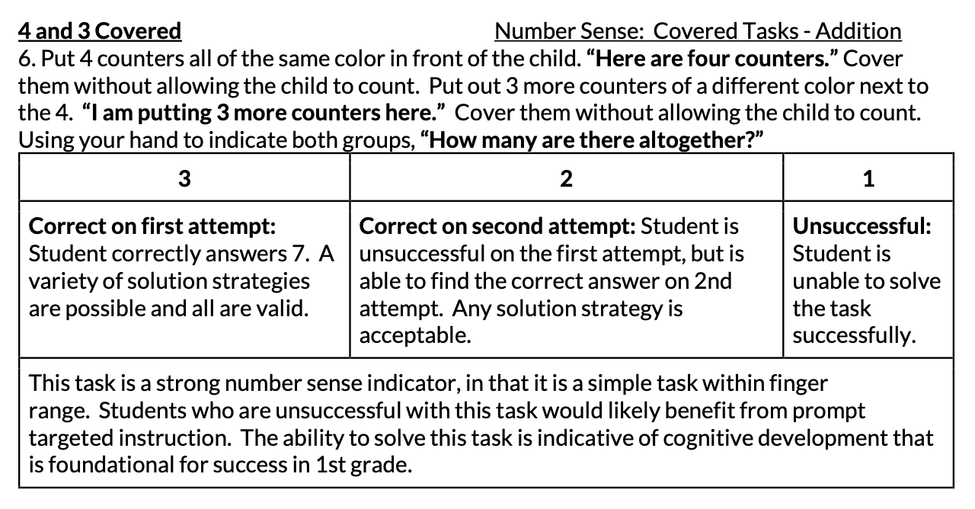
Fall Screeners: Detailed Script and Scoring Guide

Slide 22
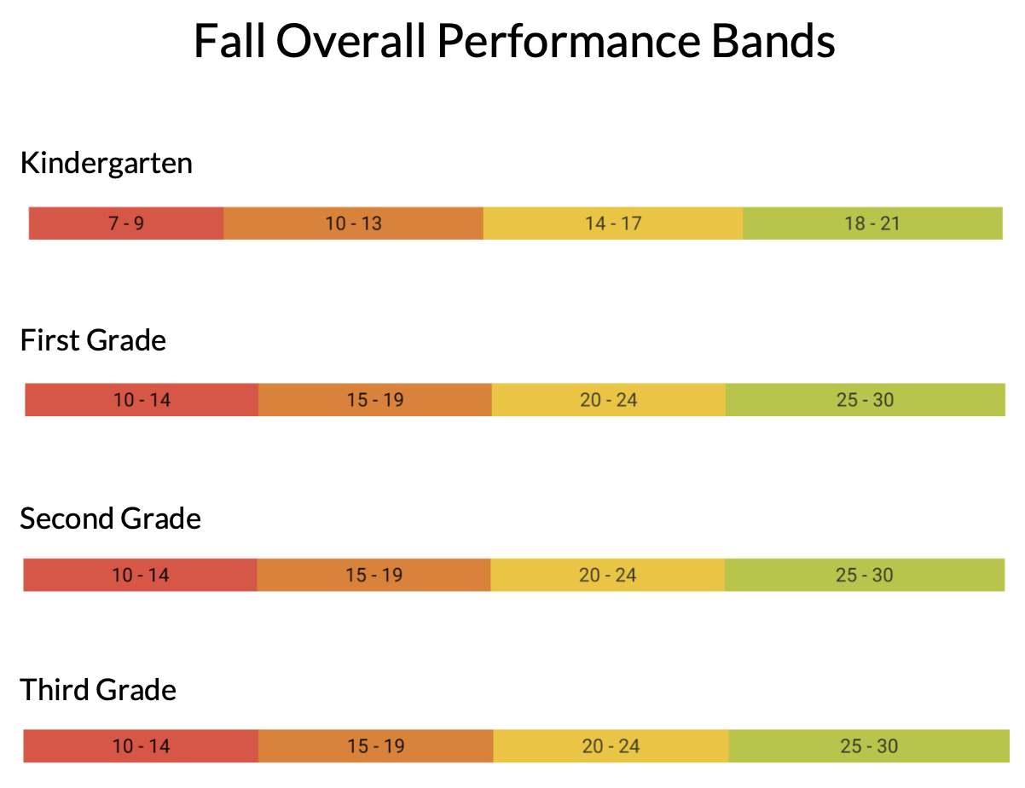
MC2M eligibility:
High needs students:
scoring in the red or orange range at student’s grade level
scoring in the red, orange, or yellow range, 1 or more grades below student’s grade level
MC2M eligibility: Score of 7 - 12

Slide 23
USNS - Dates
Screening windows:
Fall
Administer Fall screeners within first 2 weeks of tutoring
Mid-year
Retest with Fall screener during the last 2 weeks of semester

